Slide 1
18MAT333 Graph Analytics & Algorithms
Stroke Prediction Analysis
PRATIKSHA CAUVERY K.P - CB.SC.I5DAS21049
HARSHITHA.T - CB.SC.I5DAS21079

Slide 2
objective
To provide an overview of our analysis of content stroke prediction using graph-based machine learning techniques.
Discuss the dataset used, visualize the graph data, introduce the machine learning models employed, analyze centralities in the content graph, and explore the application of Graph Convolutional Networks (GCNs) in stroke prediction.
To convey our findings and insights regarding effective methods for content stroke prediction leveraging graph structures and machine learning algorithms.

Slide 3
Stroke dataset
id | gender | age | hypertension | heart_disease | ever_married | work_type | Residence_type | avg_glucose_level | bmi | smoking_status | stroke
0 | 9046 | Male | 67.0 | 0 | 1 | Yes | Private | Urban | 228.69 | 36.6 | formerly smoked | 1
1 | 51676 | Female | 61.0 | 0 | 0 | Yes | Self-employed | Rural | 202.21 | NaN | never smoked | 1
2 | 31112 | Male | 80.0 | 0 | 1 | Yes | Private | Rural | 105.92 | 32.5 | never smoked | 1
3 | 60182 | Female | 49.0 | 0 | 0 | Yes | Private | Urban | 171.23 | 34.4 | smokes | 1
4 | 1665 | Female | 79.0 | 1 | 0 | Yes | Self-employed | Rural | 174.12 | 24.0 | never smoked | 1

Slide 4
DATA OVERVIEW
Dataset size : 5110 rows × 12 columns.
Features: id,gender,age,hyoertension,heart_disease,ever_married,work_type,residence_type,avg_glucose_level,bmi,smoking_status,stroke.
Missing Values :
There are two variables that contain missing values. First, 'bmi' that accounts for 3.37% of overal samples; second, 'smoking_status' that accounts for 30.63% of overall samples. To handle these missing values, we will remove the samples from all the variables associated with the indices of missing values in 'smoking_status'. For missing values in 'bmi' variable, we will replace them with the average of 'bmi' values.
Preprocessing steps:
The steps include data cleaning, normalization, encoding categorical variables

Slide 5
Graph centralities
Degree centrality
Betweenness centrality
Closeness centrality
Eigenvector centrality

Slide 6
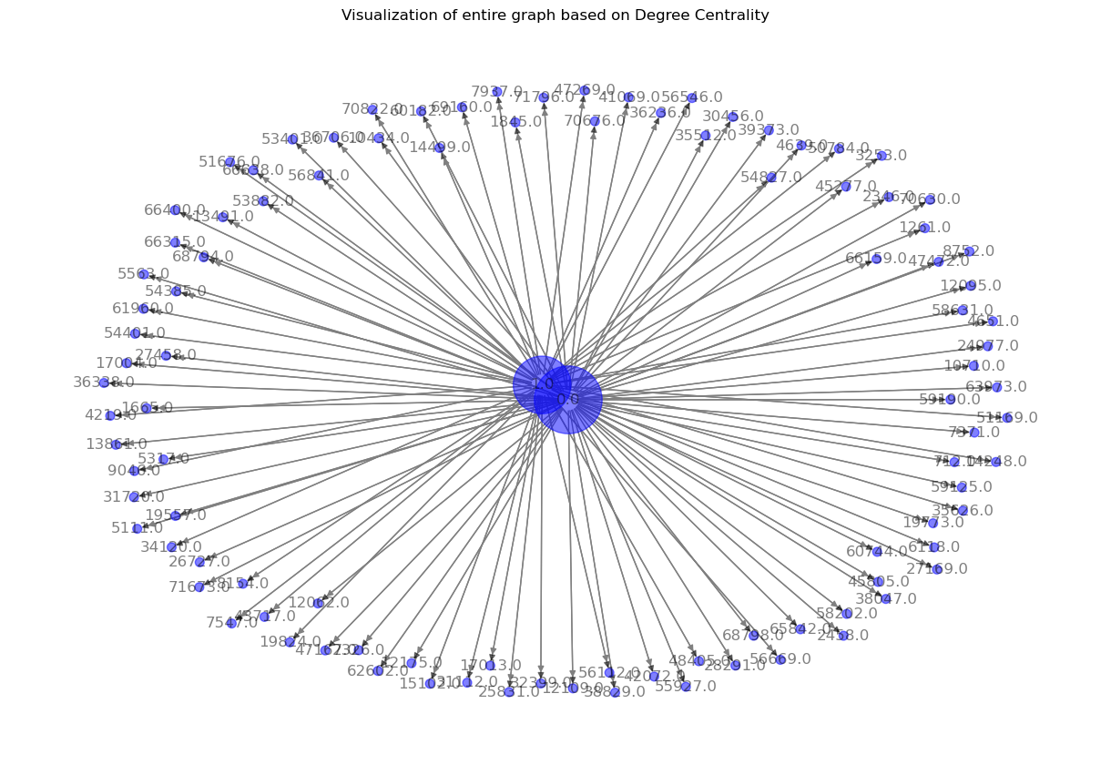
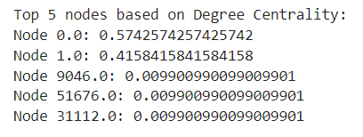
Degree centrality

Slide 7
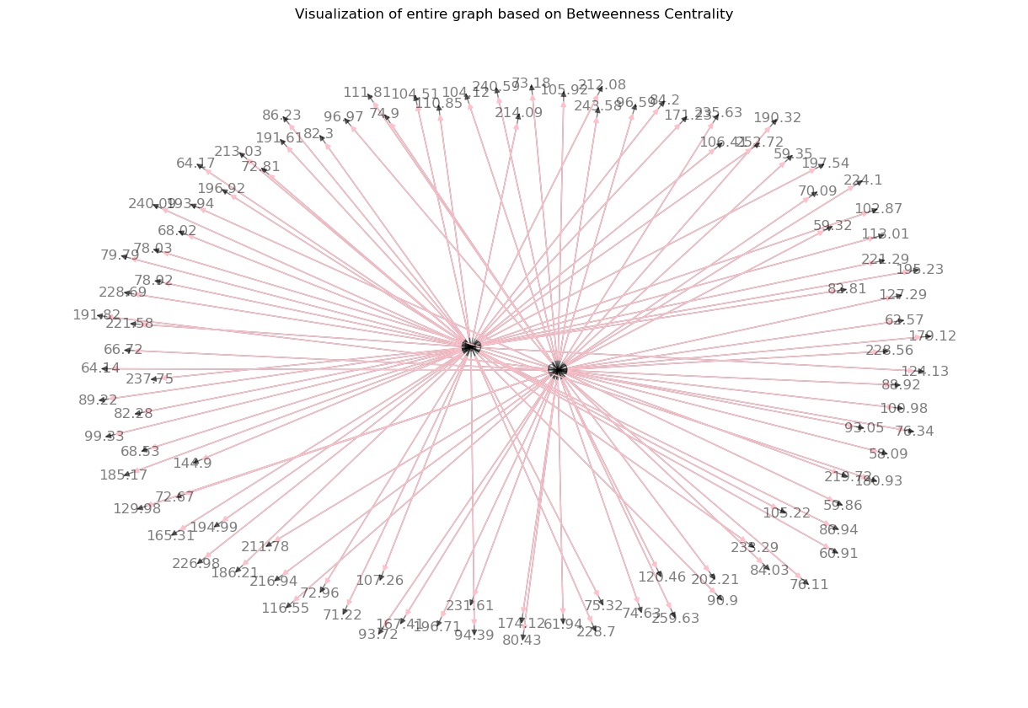
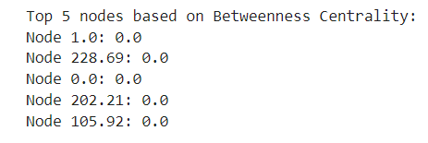
Betweenness centrality

Slide 8
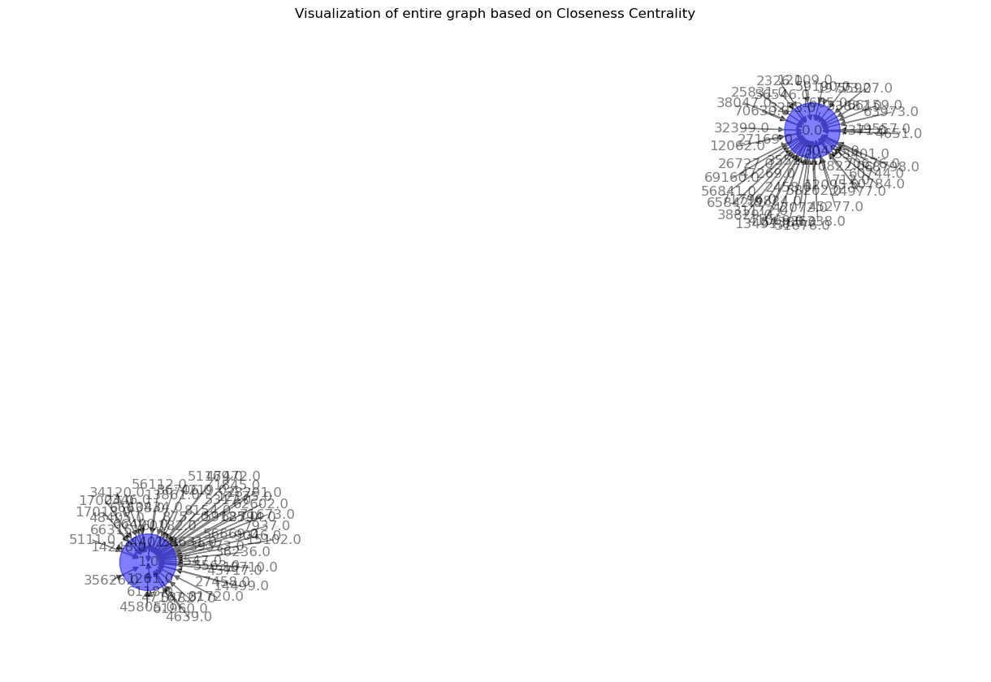
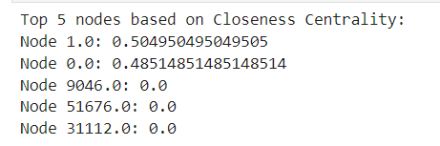
CLOSENESS CENTRALITY

Slide 9
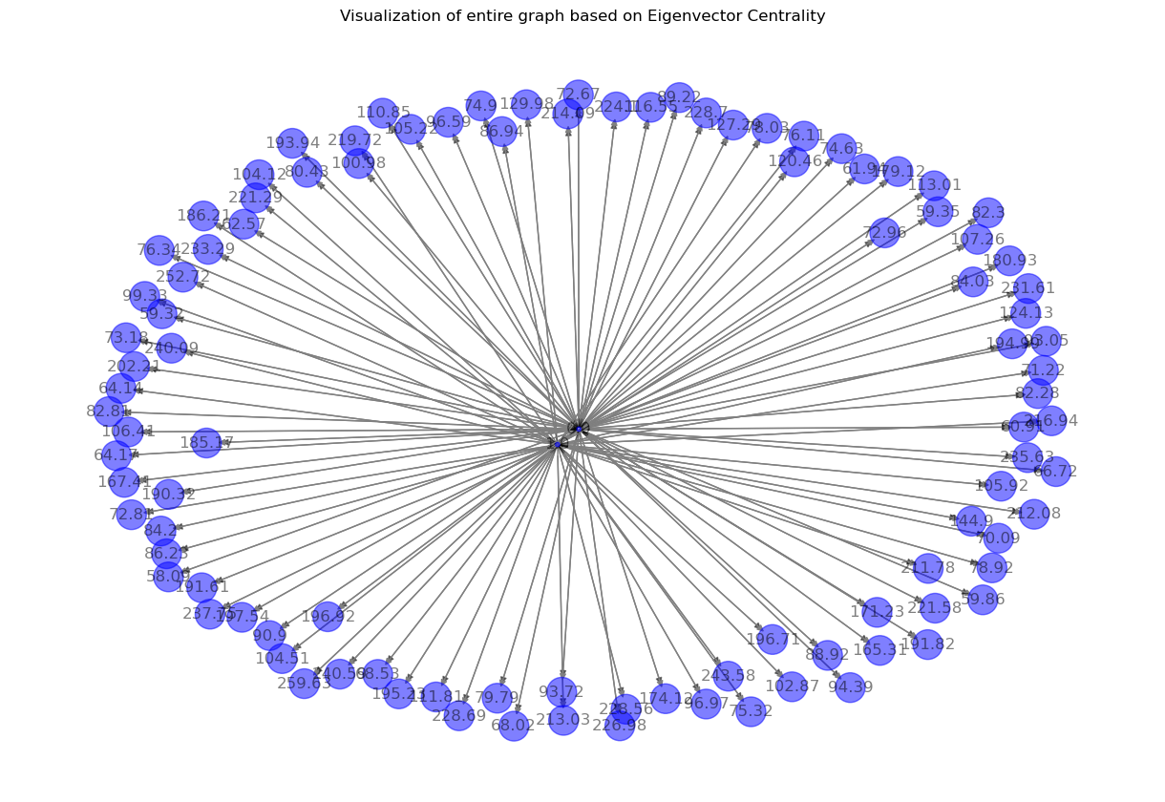
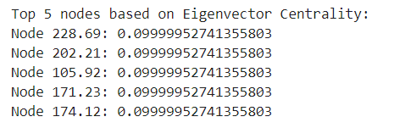
Eigenvector centrality

Slide 10
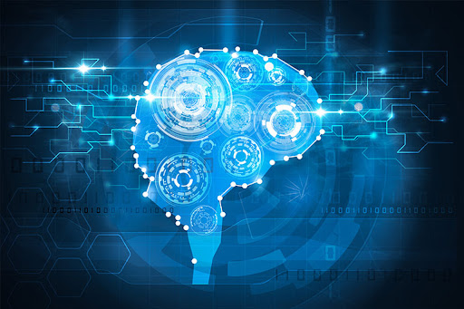
Machine learning models
Machine learning models are computational algorithms that can learn from data and make predictions or decisions without being explicitly programmed for specific tasks.
Naïve bayes
Support Vector Machine

Slide 11
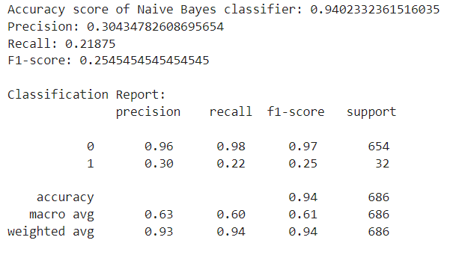
Naïve bayes

Slide 12
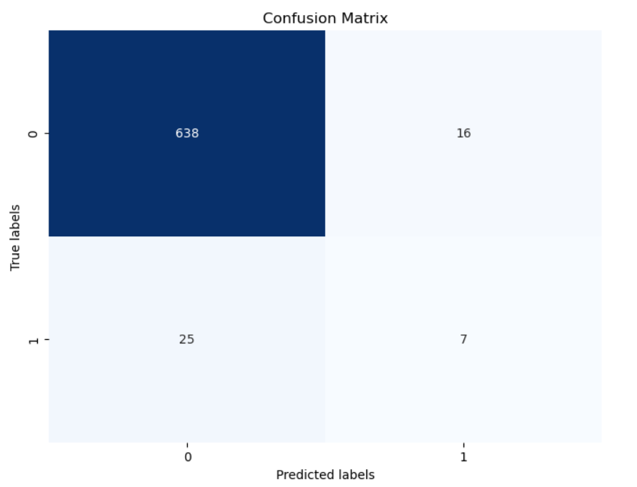
Confusion matrix

Slide 13
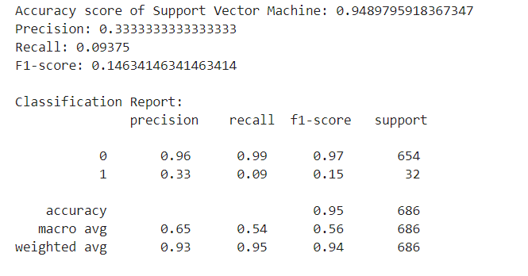
Support vector machine

Slide 14
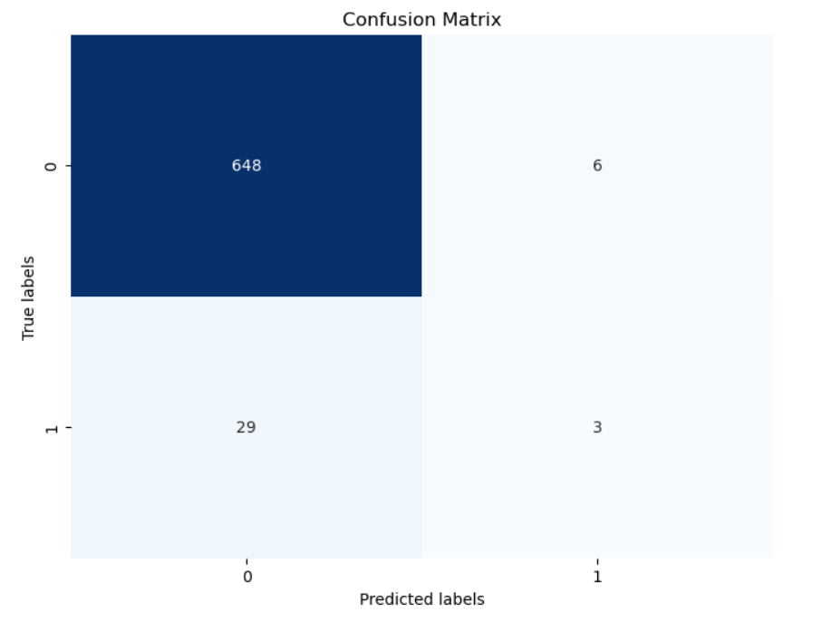
Confusion matrix

Slide 15
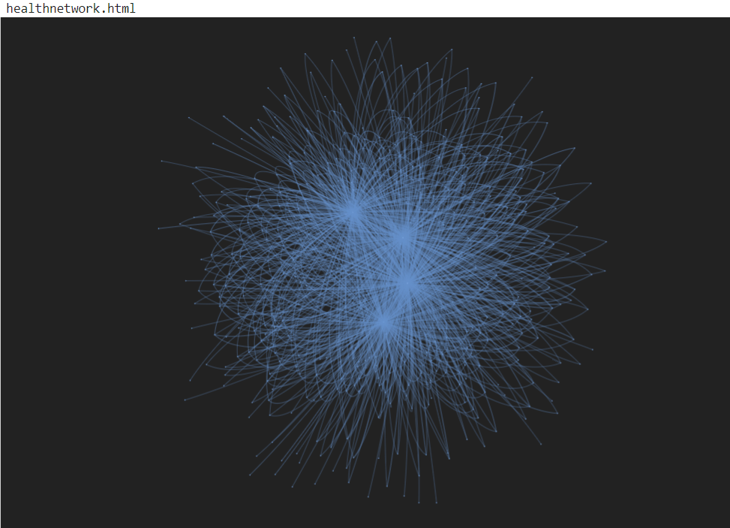
NETWORK DATA
Network data refers to data that represents relationships or connections between entities. These entities could be individuals, organizations, computers, web pages, or any other type of object, and the relationships between them can be diverse, including friendships, interactions, transactions, dependencies, or links.

Slide 16
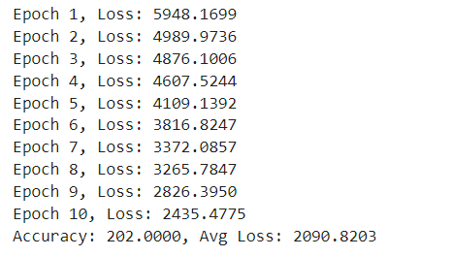
GRAPH CONVOLUTION NETWORK
Graph Convolutional Networks (GCNs) are a class of neural networks designed to operate on graph-structured data, allowing for the integration of both node features and graph topology. By performing message passing between neighboring nodes in the graph, GCNs can effectively capture complex relationships and dependencies present in the data.

Slide 17
Thank you

